Slide 1
PhysioNet Challenge – AF classification
Speaker: Yu-Cheng, Lin
Advisor:
Date: 2019/10/14

Slide 2
Outline
Analysis, Observation and solutions of the whole data
Analysis, Observation and solutions of each class of data
About QRS detector

Slide 3
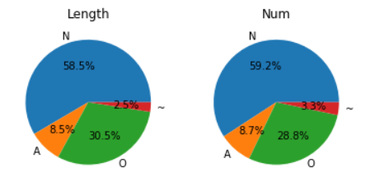
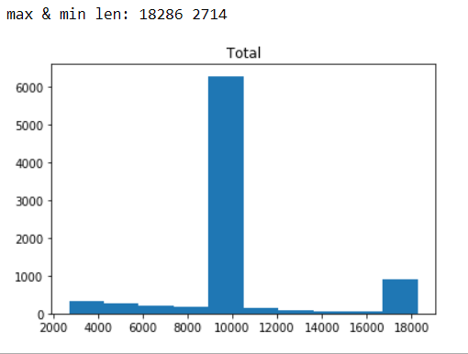
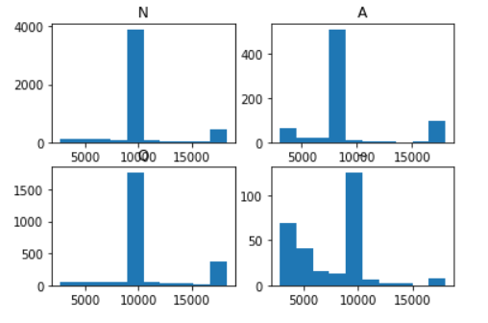
Analysis of the whole data
Amount of data of each class
Length distribution of all data
Length distribution of each class

Slide 4
Observation and solutions
Extreme data unbalancing
How it affect F1-score?
How to train it?
Large amount of signals are of length ~10000
How to padding?
Maybe all to 10000 and cut long data into half
Length distribution of noisy signal is much more different
Detect noisy data first

Slide 5
Analysis of signals of each class

Slide 6
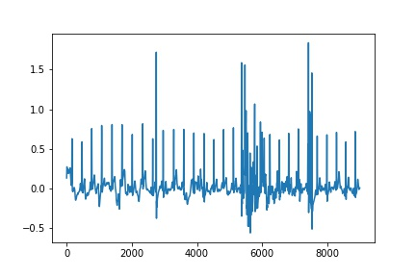
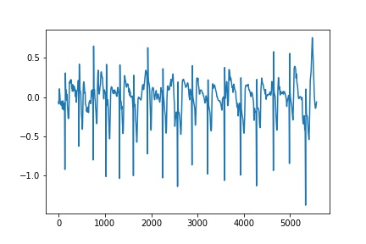
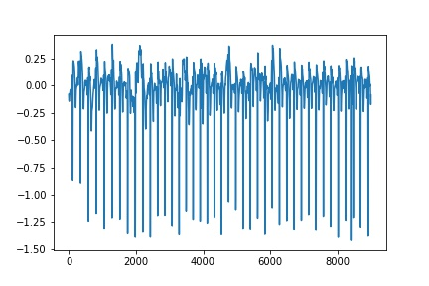
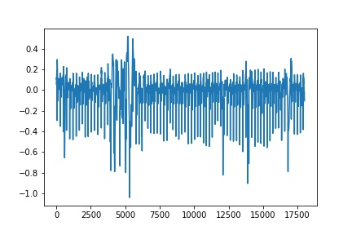
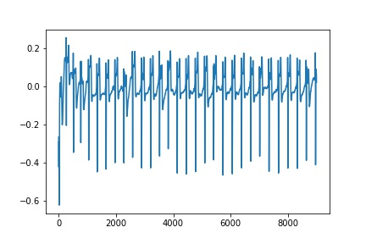
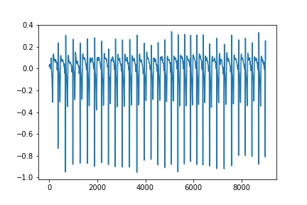
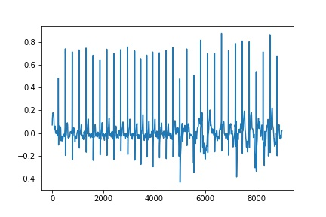
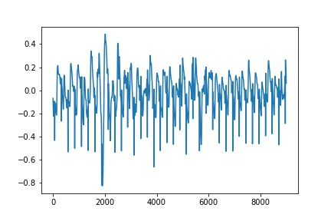
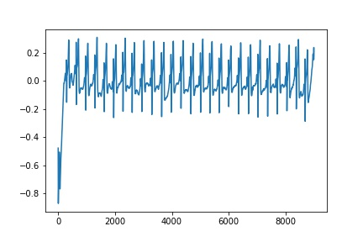
noisy
Higher peak
Normal
Flip up&down
Up?down?

Slide 7
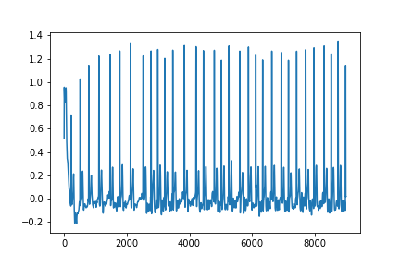
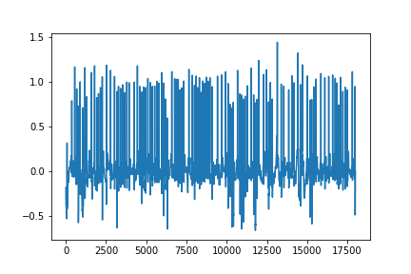
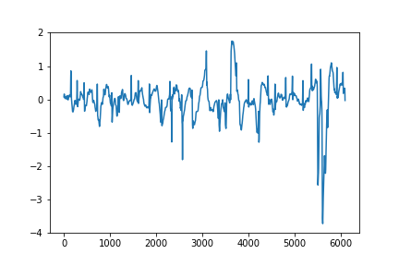
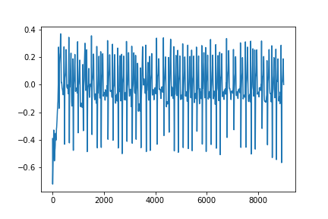
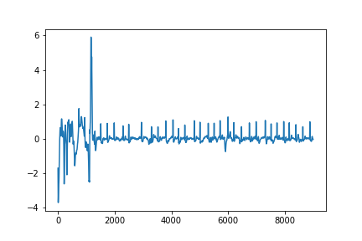
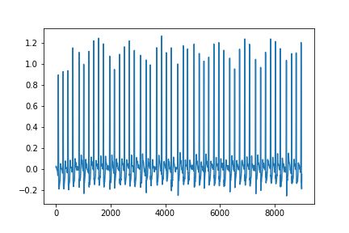
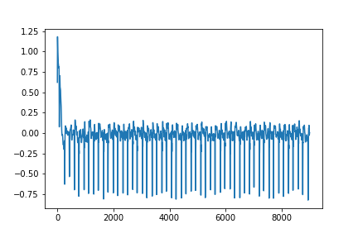
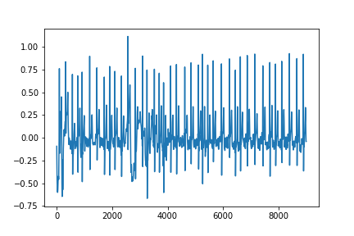
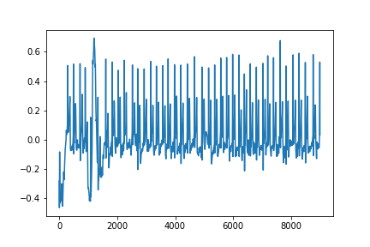
AF

Slide 8
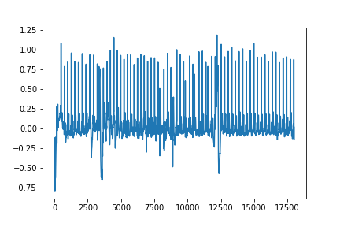
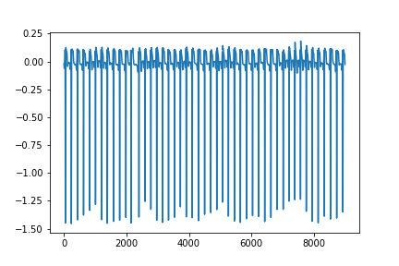
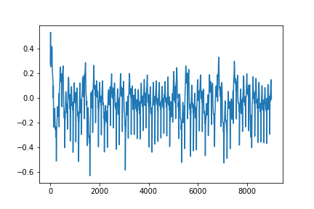
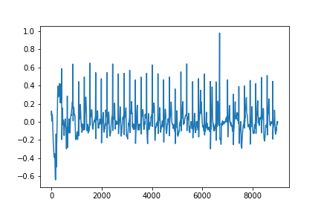
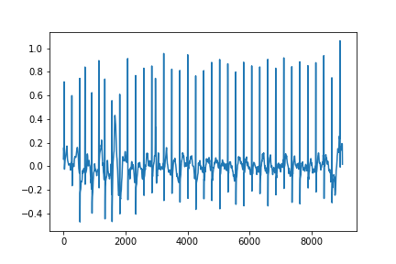
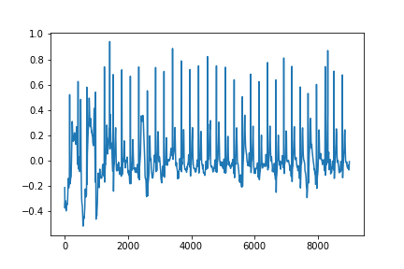
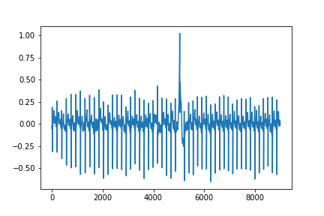
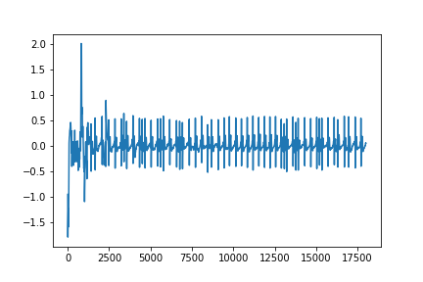
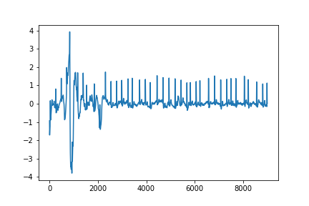
Other

Slide 9
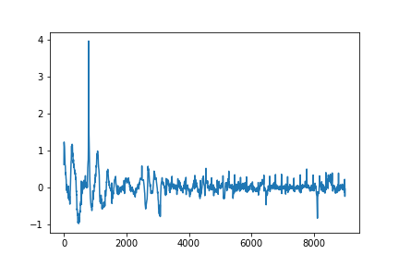
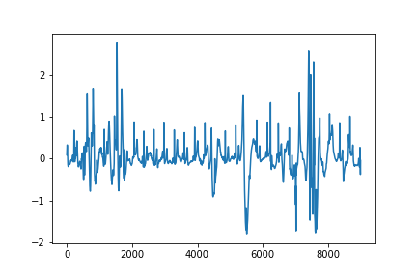
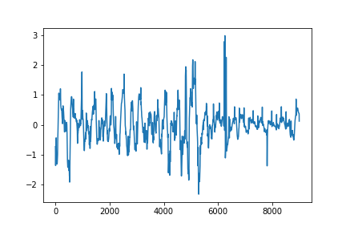
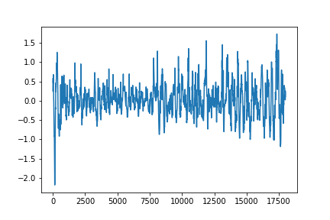
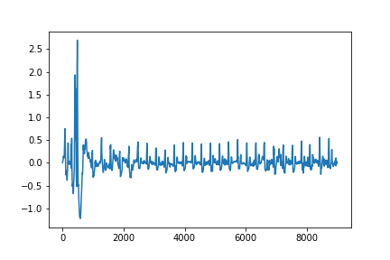
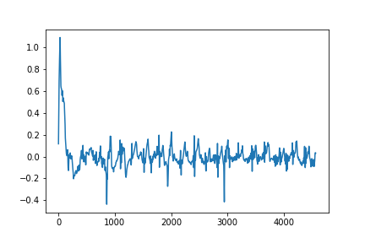
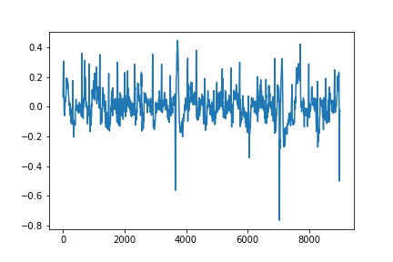
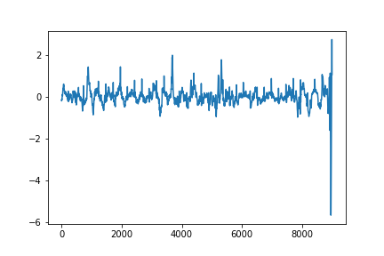
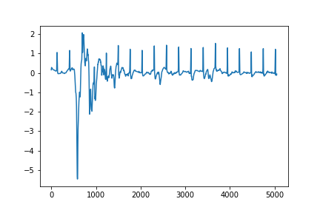
Noisy

Slide 10
Observation and solutions
N/A/O:
Some unusual pulse(usually at front): detect and remove it
Some noisy signals: detect(maybe by correlation) and remove it
Uneven average-R-peaks: normalize it
Signals upside down: flip it back but how to detect?
~:
Difficult to detect R-peaks
Often has unusual pulse

Slide 11
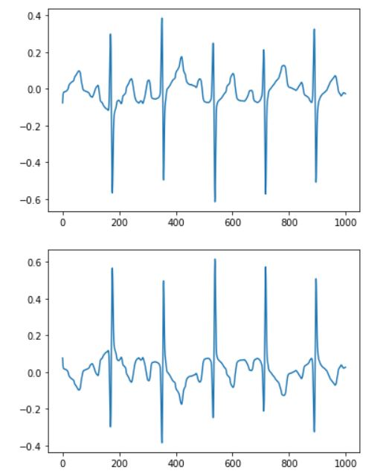
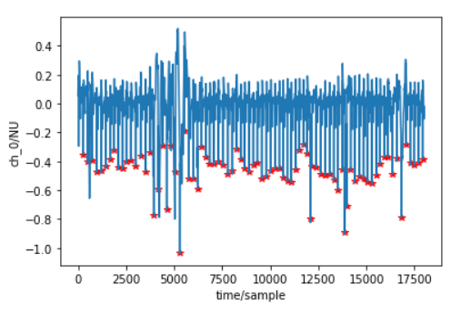
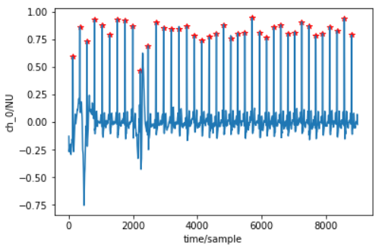
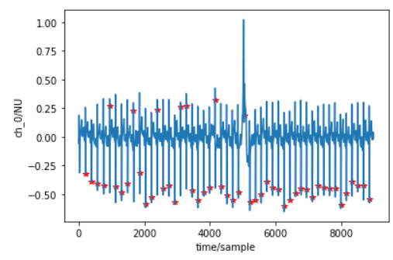
About QRS detector
Using WFDB package
XQRS detection(detect upside down ?)
XQRS detect of inverted signal is not the same
About XQRS algorithm / PAN-Tompkins algorithm

Slide 12
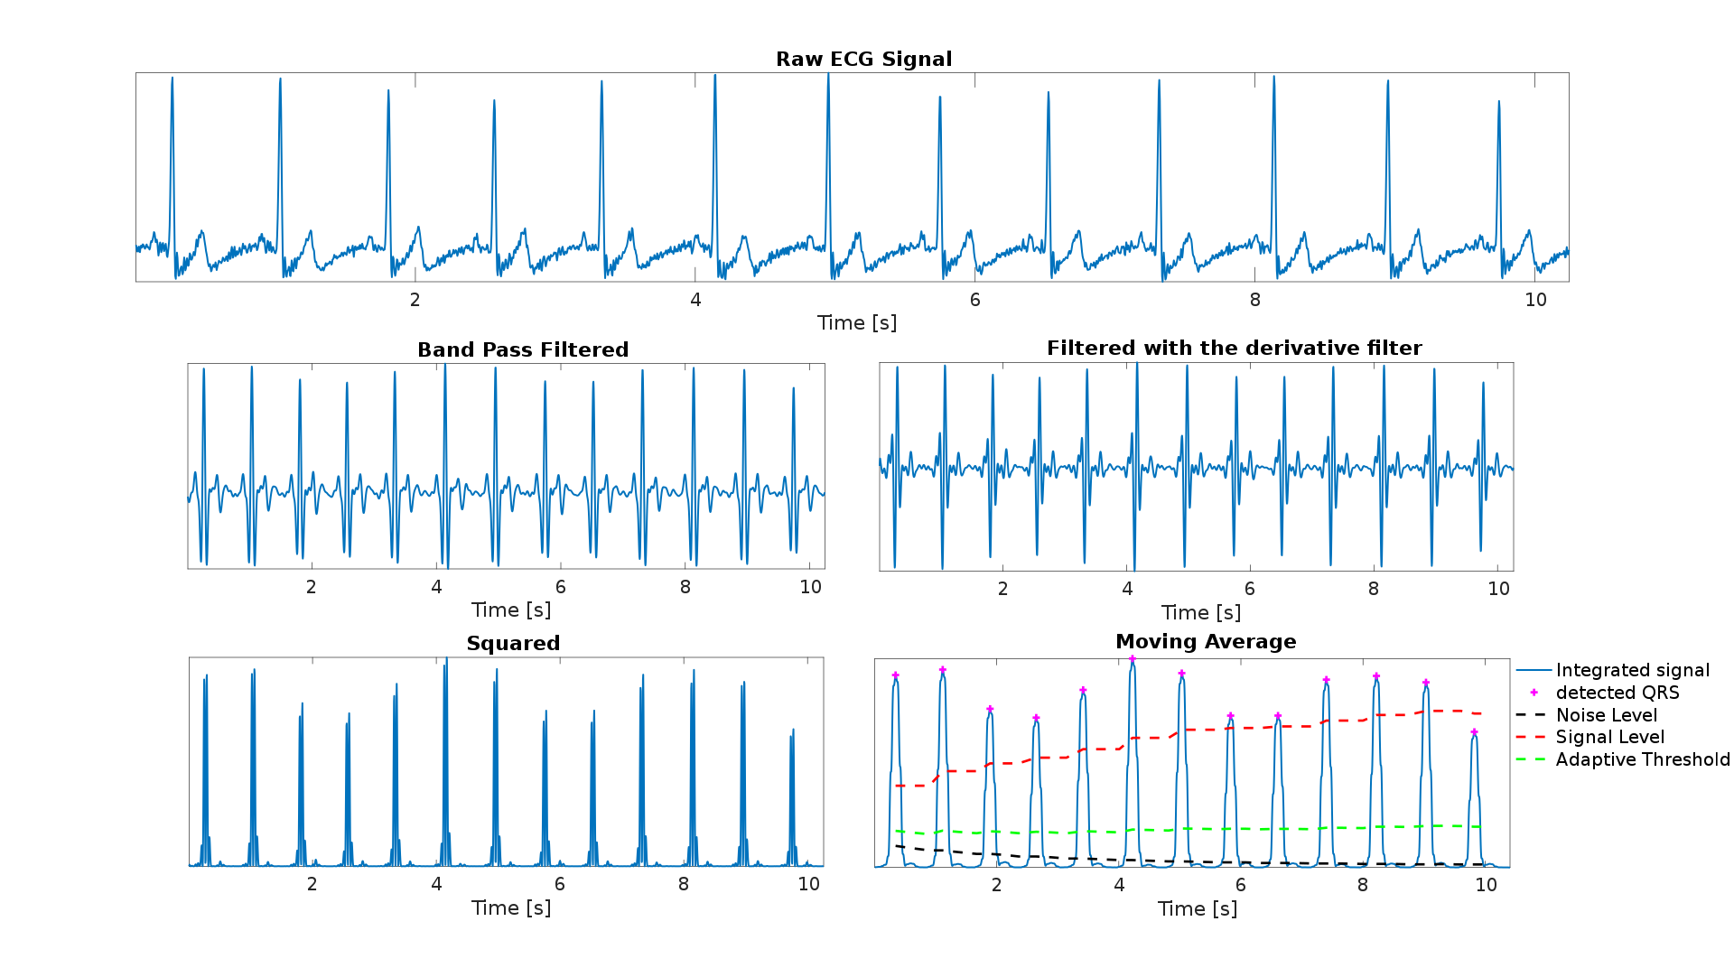
About QRS detector(Pan-Tompkins algorithm)
BP-filter(cascade by LP&HP filter in original proposal) 5~15 Hz with some specific transfer function in order to reduce muscle noise, powerline interference …
Derivative filter with specific transfer function to get the slope of QRS
Square
Moving average

Slide 13

About QRS detector(Pan-Tompkins algorithm)
Fiducial mark: the signal changes direction (from an increasing direction to a decreasing direction)
Thresholds
Each fiducial mark is considered as a potential QRS
At the beginning of the QRS detection, a 2 seconds learning phase is needed to initialize SignalLevel_{I} and NoiseLevel_{I} as a percentage of the maximum and average amplitude of the integrated signal, respectively.
The threshold is automatically updated after detecting a new peak, based on its classification as signal or noise peak
the algorithm implements a further check before confirming the peak as a true QRS, taking into consideration the information provided by the bandpass filtered signal.
Search back for missed QRS complexes
T wave discrimination
The algorithm takes particularly into consideration the possibility of a false detection of T waves.

Slide 14
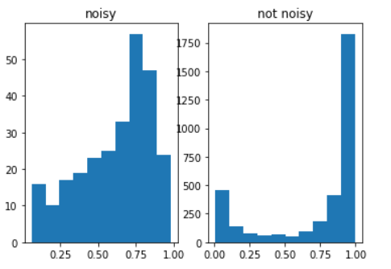
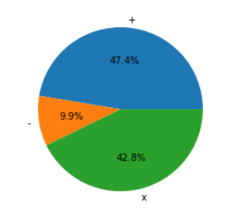
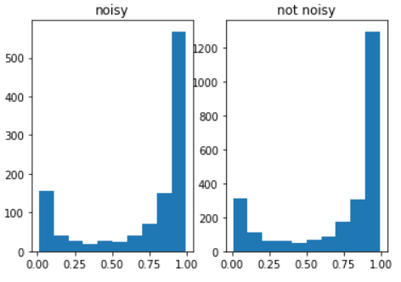
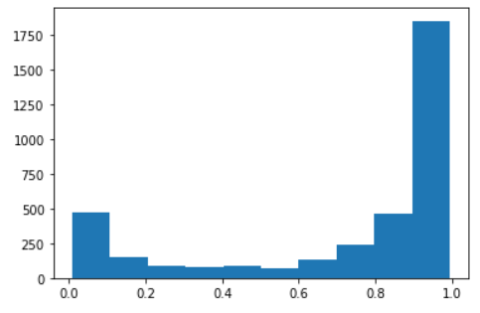
Observation
About 10% inverted signal
Distribution in ‘x’ is dependent to ‘noisy’
How to detect if a signal is inverted?
Threshold of the ratio of +/-
Others
Others

Slide 15
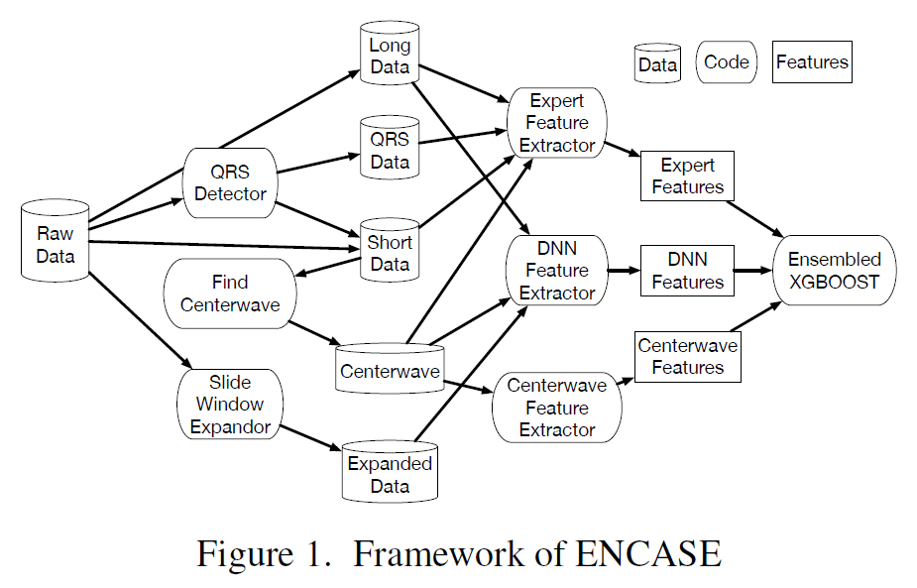
Discussion
Expanded data:
Random cutting signal
Some noisy signal maybe windowed
Short data:
Need to remove noisy & unusual signal
Raw data:
Some Noisy signal
Unusual pulse
Center wave data:
Maybe choose more center wave
QRS data:

Slide 16
Future work
Preprocessing – remove noisy & unusual signal
Solve reversal lead problem
Implement center wave data algorithm

